Slide 1
Research Methods and Practical Skills
MSc Advanced Forensic Analysis
Dr Vivien Rolfe BSc PhD
National Teacher Fellow
Twitter @vivienrolfe
Email vivien.rolfe @ uwe.ac.uk
19th September 2016

Slide 2
Research experiences and interests

Slide 3
Summary of today
Introduction and module orientation
Introduction to scientific research and critical appraisal
Science and society – the role of scientists and what skills we need?
Task 1 for this week

Slide 4
Introduction to the module
Blackboard.uwe.ac.uk
Check announcements regularly for news
Use UWE email accounts (Gmail / Yahoo sometimes get blocked)

Slide 5
Important Module Details
Can you find the Module Handbook?
Where is your timetable?
What are your deadlines?
“I love deadlines. I love the sound they make as they whoosh by”. (Douglas Adams).

Slide 6
What is research?
Can we define it?

Slide 7
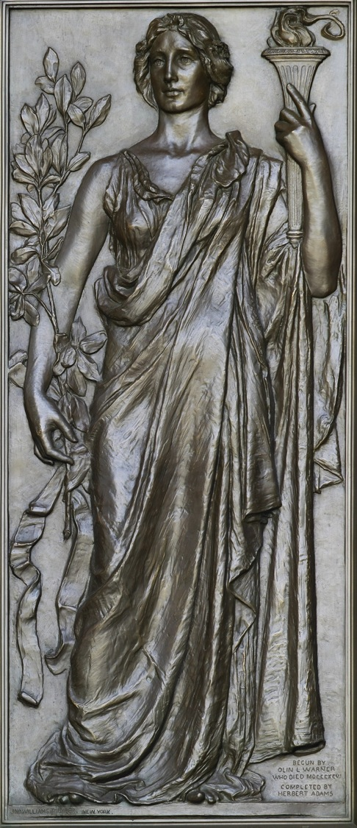
“Research holding the torch of knowledge" (1896) by Olin Levi Warner. Library of Congress, Thomas Jefferson Building, Washington, D.C.
The systematic investigation into and study of materials and sources in order to establish facts and reach new conclusions.

Slide 8
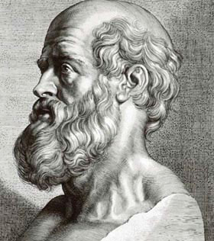
Historical perspective
Hippocrates (460BC) - “Father of Western medicine” contributing to observational research and publishing Hippocratic Corpus and other work.
“People who lisp
are liable to
prolonged diarrhoea”
“A north wind brings
constipation”
(Public domain image)

Slide 9
Historical perspective on forensic science
An ancient and fascinating history:
https://en.wikipedia.org/wiki/Forensic_science

Slide 10
Why do we need good research approaches and why do we need to develop our ‘critical thinking’?

Slide 11
We need to challenge misconceptions
“The lack of scientific knowledge among
Miracle-cure artistes, marketers and journalists
gives us some very simple ideas to test.
Their knowledge of science is rudimentary,
So as well as making basic errors of reasoning,
they also rely on notions……..from GCSE-level
science”.
Ben Goldacre (2008).

Slide 12
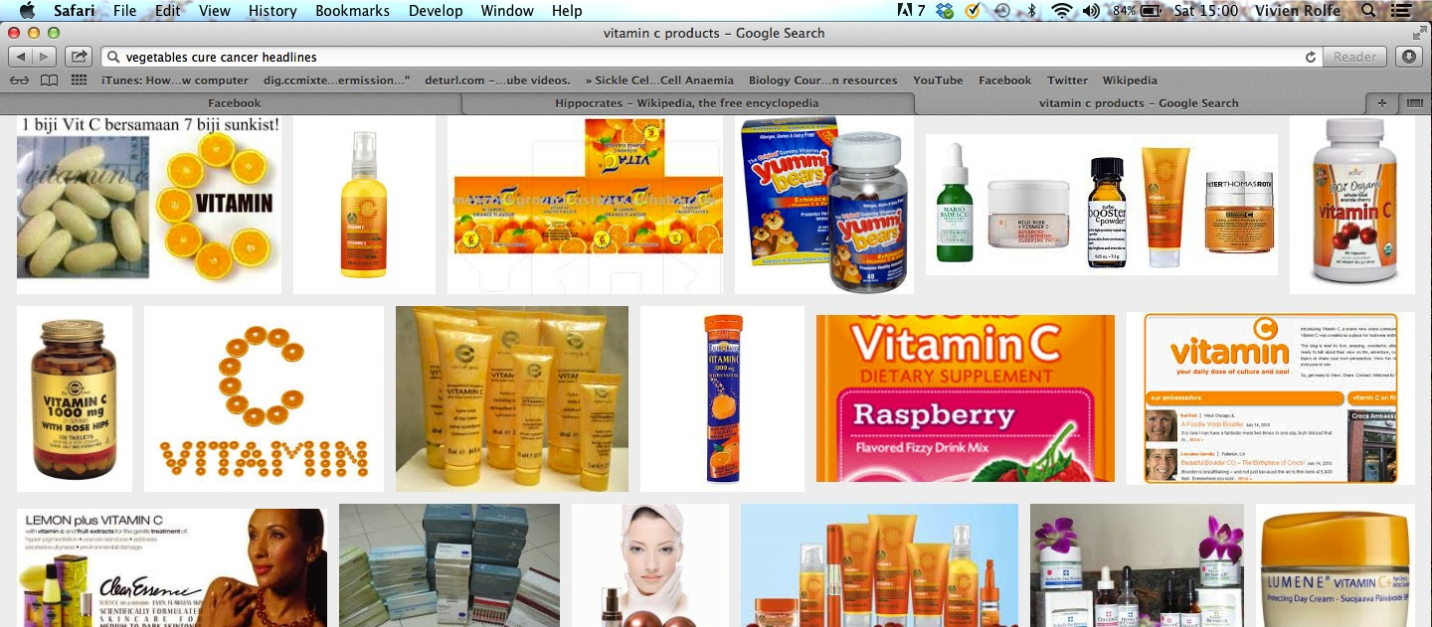
The failure of vitamin C supplementation to reduce the incidence of colds in the general population indicates that routine vitamin C supplementation is not justified, yet vitamin C may be useful for people exposed to brief periods of severe physical exercise. (Hemilä & Chalker 2013. Systematic review of 29 clinical trials).

Slide 13
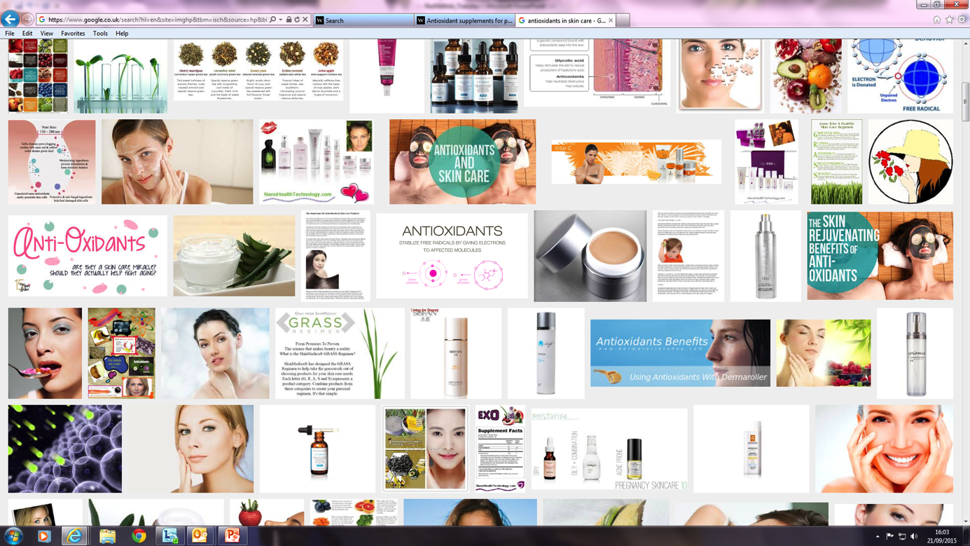
Pseudoscience
Are antioxidants good for rejuvenation and longevity?
We found no evidence to support antioxidant supplements for primary or secondary prevention. Beta-carotene and vitamin E seem to increase mortality. Antioxidant supplements need to be considered as medicinal products and should undergo sufficient evaluation before marketing. (Bjelakovic et al 2012. Review of 78 clinical trials).

Slide 14
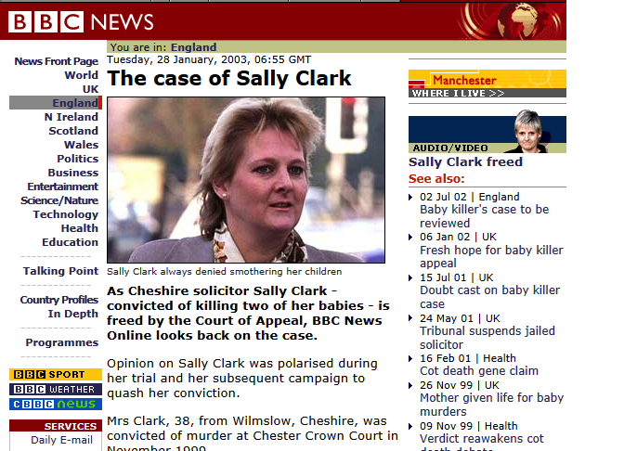
We need to not make errors in court
Convicted of double murder due to the bad use of statistics in court.
https://www.ted.com/talks/peter_donnelly_shows_how_stats_fool_juries?language=en
Ted talk around 14 mins Sally Clark.

Slide 15
What skills do we need as scientists?
1. Critical reading, thinking and writing
2. To challenge our own work and assumptions and prejudices
3. To challenge our industry

Slide 16
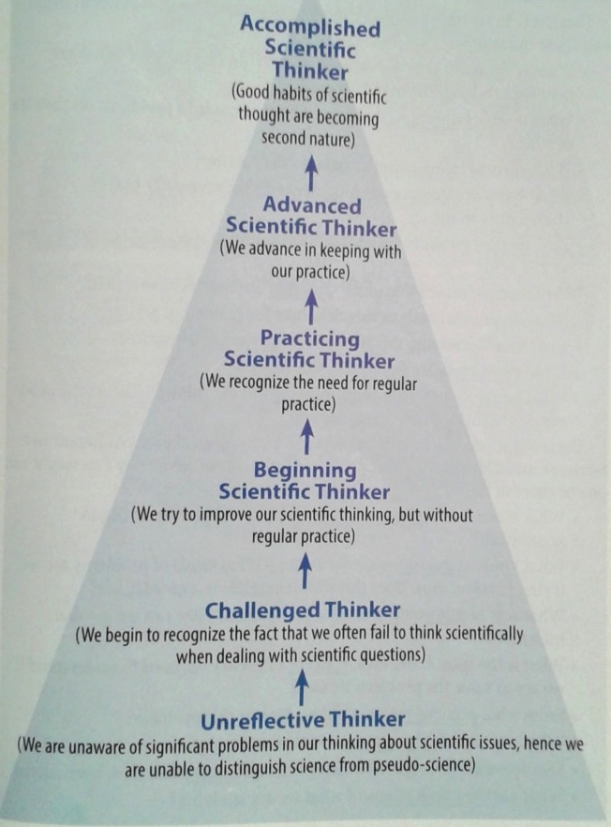
1. Critical reading, thinking and writing
Being a scientist is being able to think critically. (Trish Greenhalgh’s work)
We need to develop
our scientific minds.
(criticalthinking.org)
© Criticalthinking.org

Slide 17
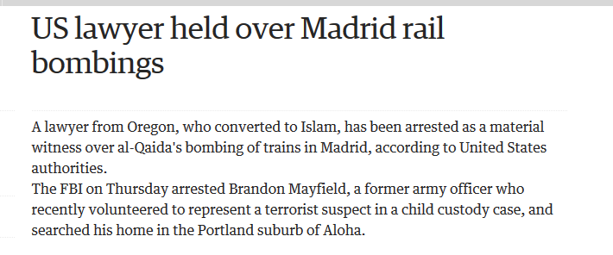
2. To challenge our own assumptions and prejudices
Information
Inferences
‘Unconscious bias’
Our prejudices, cultural differences, assumptions, bias

Slide 18
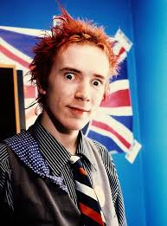
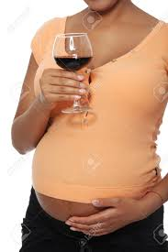
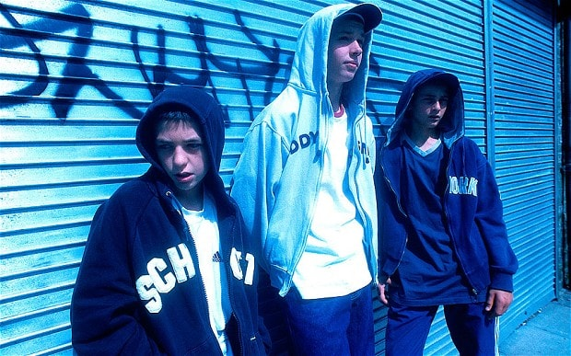

Slide 19
3. To challenge our industry
Gender and cultural bias rife in scientific research – industry and universities.https://www.timeshighereducation.com/news/sexist-peer-review-causes-storm-online/2020001.article?utm_content=bufferad1ee&utm_medium=social&utm_source=twitter.com&utm_campaign=buffer
Double blind peer review significantly increased numbers of female authors in top journal.http://blogs.nature.com/peer-to-peer/2008/01/doubleblind_peer_review_reveal.html
9% of those in non-medical STEM career jobs are women. BME men 28% less likely to work in STEM than white males. Campaign for Science and Engineering (2014).

Slide 20
“The information, conclusions and opinions published in forensic science journals might one day be proffered as evidence in criminal or civil litigation”.
(Jones 2007).

Slide 21
Task for this week
Pick a topical news story about forensic science and write me a 250 word CRITIQUE of it. Send me what you think at this stage a CRITIQUE of it would be.
Use the University of Leicester webpages:
http://www2.le.ac.uk/offices/ld/resources/writing/writing-resources/critical-writing
Email to Viv by Tues 27th September and I’ll return it to you with feedback.

Slide 22
References
Bjelakovic G, Nikolova D, Gluud LL, Simonetti RG, Gluud C. Antioxidant supplements for prevention of mortality in healthy participants and patients with various diseases. Cochrane Database of Systematic Reviews 2012, Issue 3. Art. No.: CD007176. DOI: 10.1002/14651858.CD007176.pub2.
Campaign for Science and Engineering (2014). Available at: http://sciencecampaign.org.uk/CaSEDiversityinSTEMreport2014.pdf
Else H (2015). The Times Higher. REF 2014 cost almost £250 million. Available: https://www.timeshighereducation.com/news/ref-2014-cost-250-million
Greenhalgh, T., & Taylor, R. (2002). How to read a paper. London: BMJ Publishing Group. Available: http://www.bmj.com/about-bmj/resources-readers/publications/how-read-paper
Hemilä H, Chalker E. Vitamin C for preventing and treating the common cold. Cochrane Database of Systematic Reviews 2013, Issue 1. Art. No.: CD000980. DOI: 10.1002/14651858.CD000980.pub4.
Jones, A.W., 2007. The distribution of forensic journals, reflections on authorship practices, peer-review and role of the impact factor. Forensic science international, 165(2), pp.115-128.

